Slide 1


Wisbai Bank
ATM Transaction Report
From January 1st, 2022 to December 31st, 2022

Slide 2
Table of contents
01
02
03
Overview
Transaction
Frequency
Duration and Count
04
05
Trends
Recommendations

Slide 3

Overview
01

Slide 4
₦38,555,885,000
Total amount processed by Wisabi ATMs in 2022
2,143,838
Transactions Performed
8,819
Unique Customers
12.9%
Utilization Rate

Slide 5
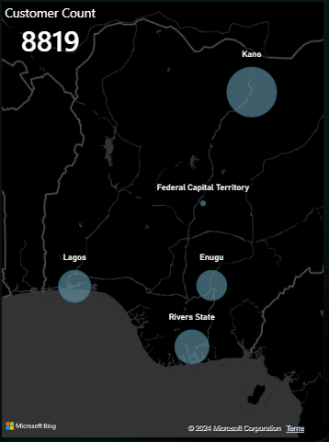
Utilization
Rate
ATMs in Kano have the highest Utilization Rate of 18.6%
Rivers & Lagos have Utilization Rates of 12.7% & 12.2% respectively while Enugu is 11.6%
The FCT has the lowest Utilization Rate at 8.5%

Slide 6

02
Transaction
Frequency

Slide 7

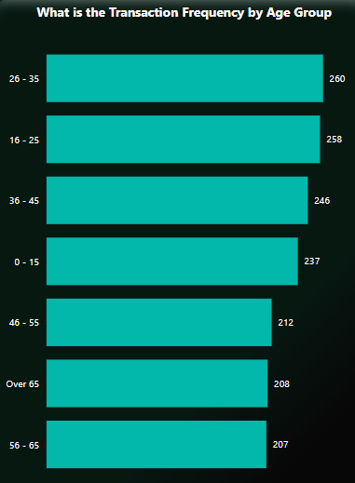
Insights
Customers between 26-35 years have the highest transaction frequency at 260.
Followed closely by the age cohort of 16 - 25
The age 56 - 65 cohort has the least amount of transactions

Slide 8

03
Duration and Count

Slide 9
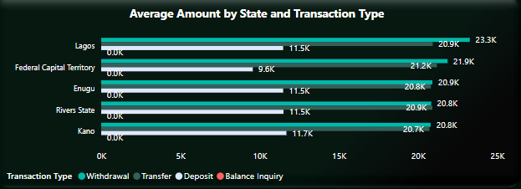
Average
Transaction
Amount
On Average, Withdrawals have the highest transaction amounts across all states, next is Transfers, with Deposits being the lowest.
The FCT has comparatively lower Deposit amounts on Average across all states

Slide 10
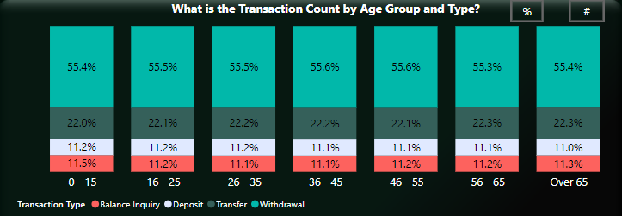
Transaction Count
Across all Age Groups, Withdrawals is the common transaction type (>50%), followed by Transfers (>20%)
Deposits & Transfers account for a significant amount of all transactions (>10% each) across all Age Groups

Slide 11
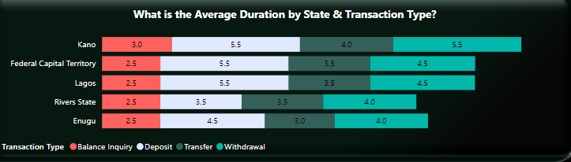
Average
Transaction
Duration
Withdrawals takes the longest on average across all states
Kano’s average transaction durations are comparatively higher than other locations.
Rivers & Enugu have lower average transaction duration for Deposits, Transfers, & Withdrawals when compared to other locations.

Slide 12

Trends
04

Slide 13

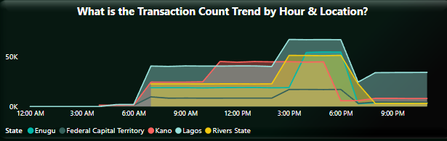
Daily Transaction Trend
ATM Transactions in Lagos increase gradually from 6 am and peaks between 3 and 7 pm.
Similar behavior is seen across other states however transactions peak earlier in Kano (around 11 am) and this is sustained till about 5 pm after which activity sharply declines.
Compared to other states, Lagos has significant transactions activity after 7 pm

Slide 14
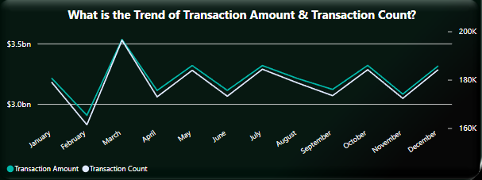
Transaction Amount & Count Trend
The highest number of transactions and transaction amount occurred in March
Other months with high transaction activity include January, May, July, October, and December
The lowest number of transactions and transaction amount occurred in February

Slide 15

05
Recommendations

Slide 16

Utilization Rate
ATM Visibility
Incentives
Consider relocating the ATMs to more prominent locations, installing signage, or improving lighting and landscaping around the ATMs.
Consider offering additional services at the ATM, such as the ability to deposit checks or make cash withdrawals in different denominations.

Slide 17

Transaction Duration
in Kumo
Increase ATMS
Maintenance
Upgrade ATMs
Increase the number of ATMs available in the branch, as this can reduce wait times and congestion at each individual ATM.
Ensure that the ATMs are regularly serviced and maintained to prevent downtime and minimize technical issues that can contribute to longer transaction times.
Consider upgrading the ATMs to newer models with faster transaction times and more advanced features.

Slide 18
Transactions Activity
ATM Availability
Maintenance
ATMs should have maximum availability especially during the peak activity periods for each bank branch.
Scheduled maintenance should coincide with these periods of reduced activity

